Slide 1

CPSC 597 Project Presentation: ETH Price Prediction with LSTM
Created by John Tu
Advisor: Dr. Rong Jin
Reviewer: Dr. Kanika Sood

Slide 2
Overview
The research project is about predicting future prices of Ethereum (or ETH) via implementation of LSTM-RNN (or Long Short-Term Memory Recurrent Neural Network) models
This topic is based on similar experiments from related papers where authors develop and implement neural networks in forecasting models to predict future prices of stock markets for most stock indices and currencies across the globe
While price prediction is an engaging topic in being able to predict the future trends of cryptocurrencies, it has yet to capture attention of the public in the financial headlines and remains overshadowed by other trending issues in the marketing world.
The goal of this project is to not only predict next year’s prices of Ethereum, but to also verify whether LSTM is still capable in accurately predicting future prices.

Slide 3
What is LSTM?
LSTM (or Long Short-Term Memory) is a subtype of RNN (recurrent neural network) where it relies on having each state reading in the memory from the preceding ones. They are designed to reduce exploding and vanishing gradients in neural networks.
Each LSTM cell contains an input, forget, and output gate in order to control the flow on how much each incoming data from the preceding cell can be stored and retained for some period of time (hence the term long-term dependency).
Applications of LSTM networks include text processing, machine translation, stock market prediction, audio visualization, etc.
By itself, LSTM is capable in applications leaning towards temporal data, though it is not uncommon to see hybrid neural networks also supplementing LSTM with other methodologies, such as convolutional neural networks.

Slide 4
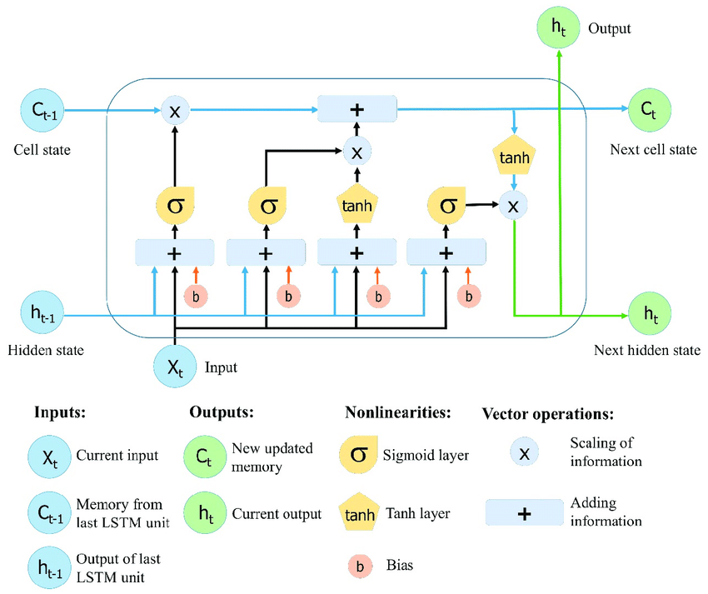
Image from https://www.researchgate.net/figure/The-structure-of-the-Long-Short-Term-Memory-LSTM-neural-network-Reproduced-from-Yan_fig8_334268507

Slide 5
Experiment Procedure
Part 1: Dataset lengths
The following datasets are defined based on training and test length: 70-30, 80-20, 75-25, and custom (all data before April 1, 2022, as training and all data since April 1, 2022, as test)
Part 2: Comparison with other models
The following models will be used to compare alongside with LSTM: MLP, CNN, GRU, BiLSTM, BiGRU, CNN-LSTM, CNN-GRU, CNN-BiLSTM, CNN-BiGRU, LSTM-GRU, CNN-LSTM-GRU
All models for both parts will use the following features: baseline, with dropout rates, with regularizers, and with dropout rates and regularizers combined

Slide 6
Part 1 Experiment
ETH price list sorted by day obtained from Yahoo Finance and closing price considered
4 datasets created based on length of training and test:
70% training, 30% test
80% training, 20% test
75% training, 25% test
Custom (Before 4/1/2022 as training, Since 4/1/2022 as test)
Batch normalization applied before setting up the features and labels for each dataset
Time steps used for the experiments: 30 steps (approximately equivalent to 1 month)
All models will use early stopping and will be trained for 100 epochs.
The metrics used to measure training losses will be mean squared error (MSE), mean absolute error (MAE), and root mean squared error (RMSE).
After training and evaluating, the predicted results have their original values restored by undoing batch normalization, and then plotted alongside with the actual data.

Slide 7
Part 2 Experiment
For this experiment, the following training and test lengths will be defined as followed: all data before April 1, 2022 as training and all data since April 1, 2022 as test
The experiment will be the same as Part 1, except the custom length training-test dataset will be used (see above), and in addition to LSTM, additional neural network models will be implemented as followed:
Multilayer perceptron (MLP)
1-dimensional convolutional neural network (1D-CNN)
Gated recurrent unit (GRU)
Bidirectional LSTM (BiLSTM)
Bidirectional GRU (BiGRU)
Hybrid models (CNN-LSTM, CNN-GRU, CNN-BiLSTM, CNN-BiGRU, LSTM-GRU, and CNN-LSTM-GRU)

Slide 8
Results
The next few slides ahead will show the training loss graphs and the predicted plots based on the following features added for both Parts 1 and 2.

Slide 9
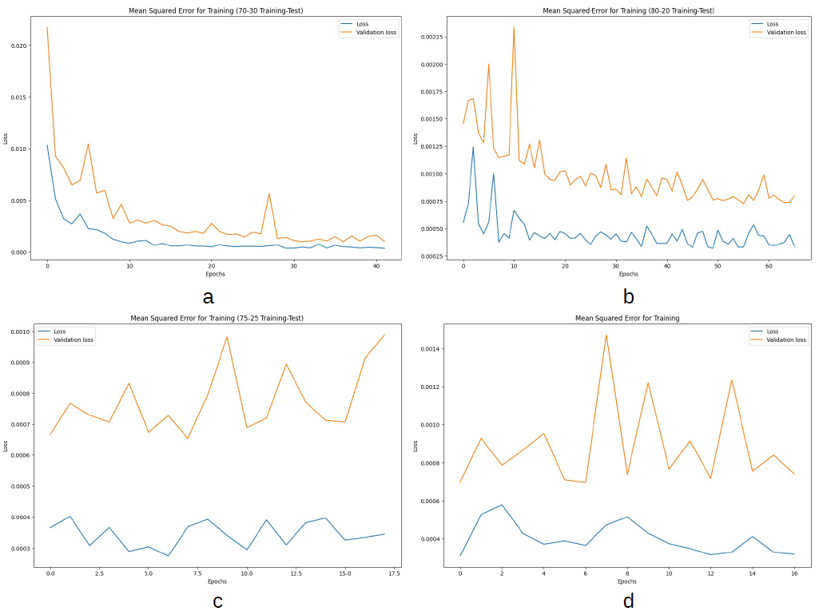
Part 1 Results
Training losses for baseline LSTM model (a: 70-30 training-test, b: 80-20 training-test, c: 75-25 training-test, d: custom training-test).

Slide 10
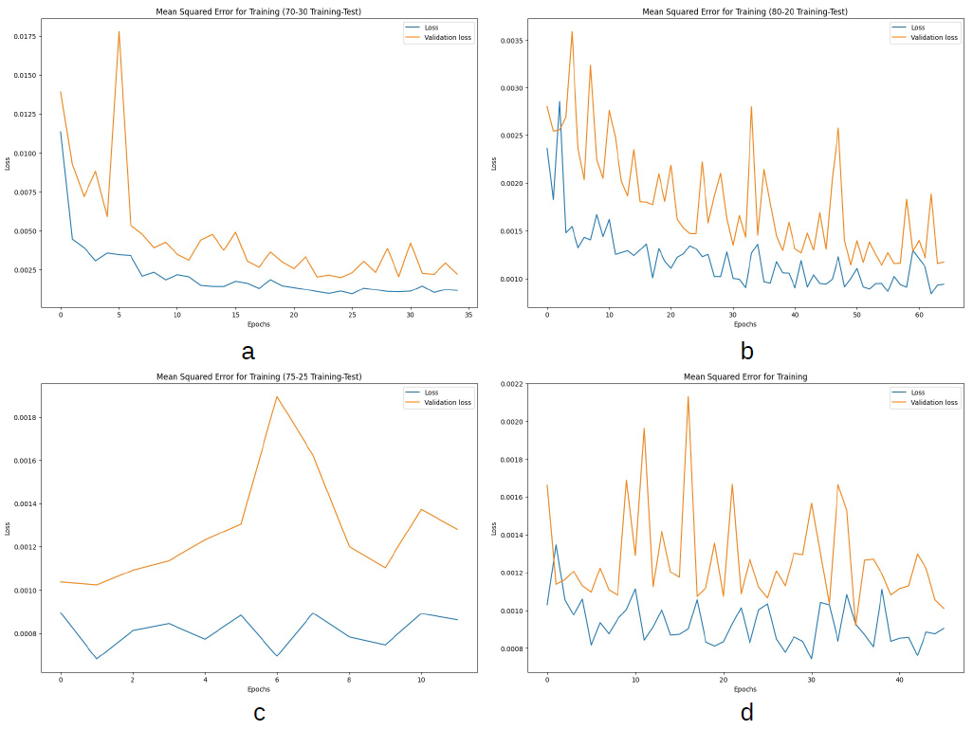
Part 1 Results
Training losses for LSTM model with dropout rates (a: 70-30 training-test, b: 80-20 training-test, c: 75-25 training-test, d: custom training-test).

Slide 11
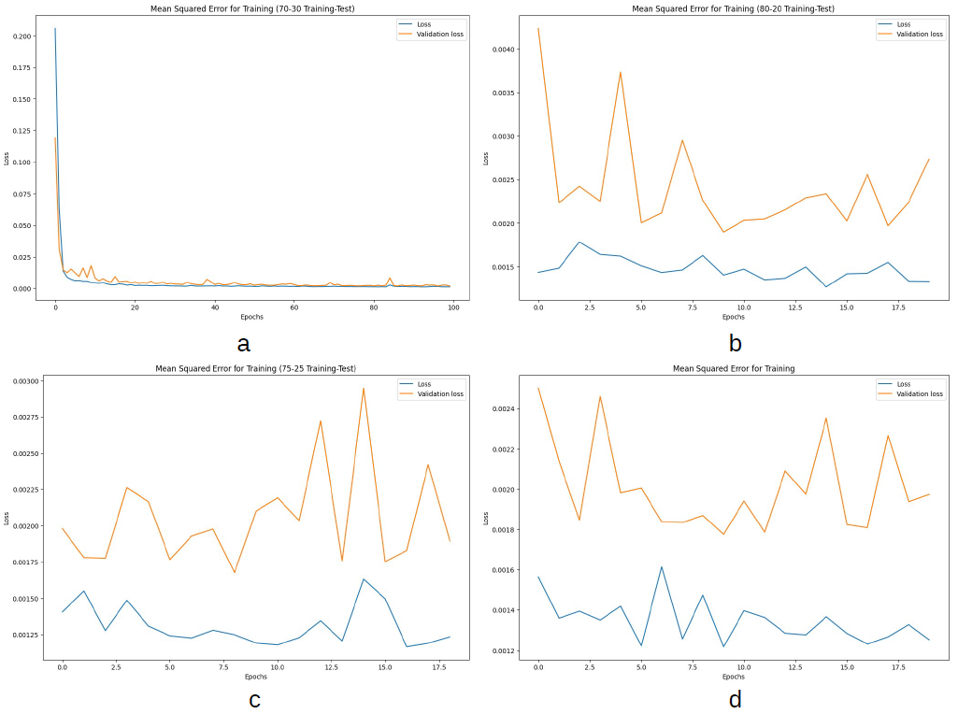
Part 1 Results
Training losses for LSTM model with regularizers (a: 70-30 training-test, b: 80-20 training-test, c: 75-25 training-test, d: custom training-test).

Slide 12
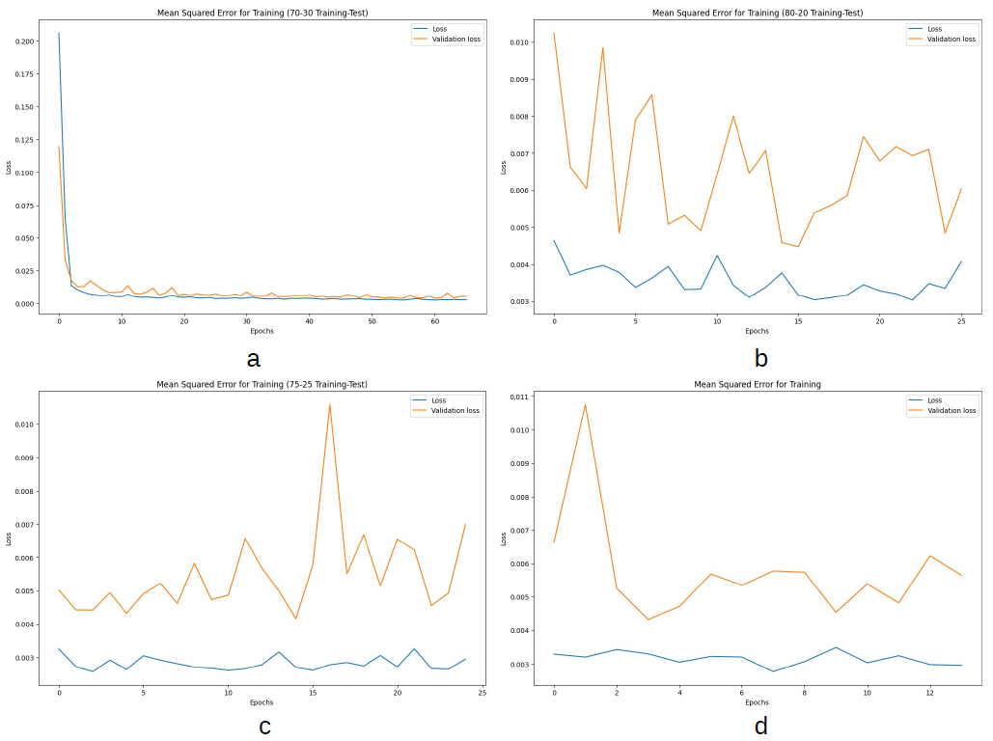
Part 1 Results
Training losses for LSTM model with dropout rates and regularizers (a: 70-30 training-test, b: 80-20 training-test, c: 75-25 training-test, d: custom training-test).

Slide 13
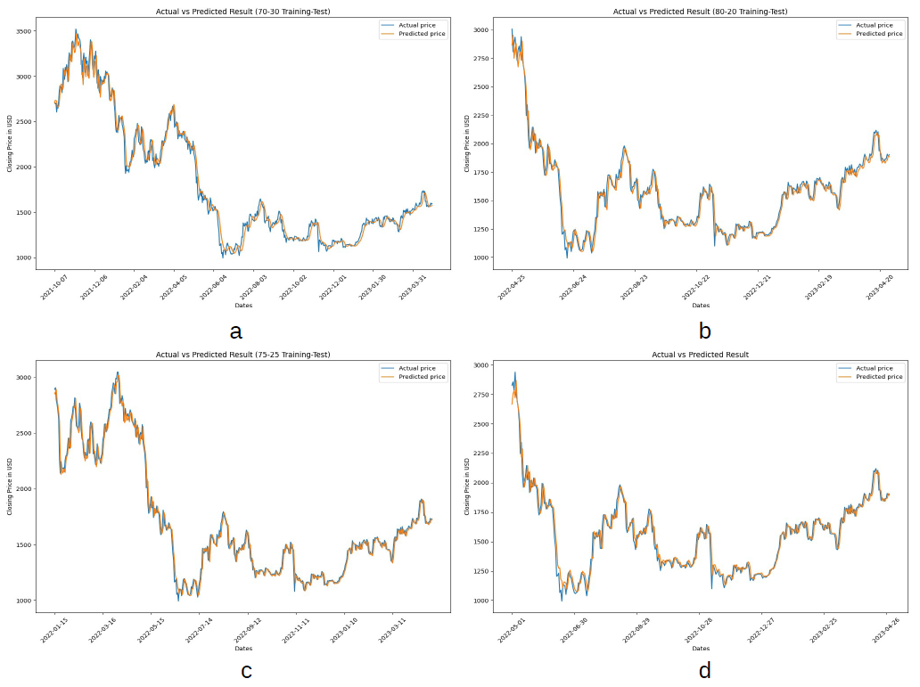
Part 1 Results
Plots of test set for predicted values of closing price compared with actual values for baseline LSTM model (a: 70-30 training-test, b: 80-20 training-test, c: 75-25 training-test, d: custom training-test).

Slide 14
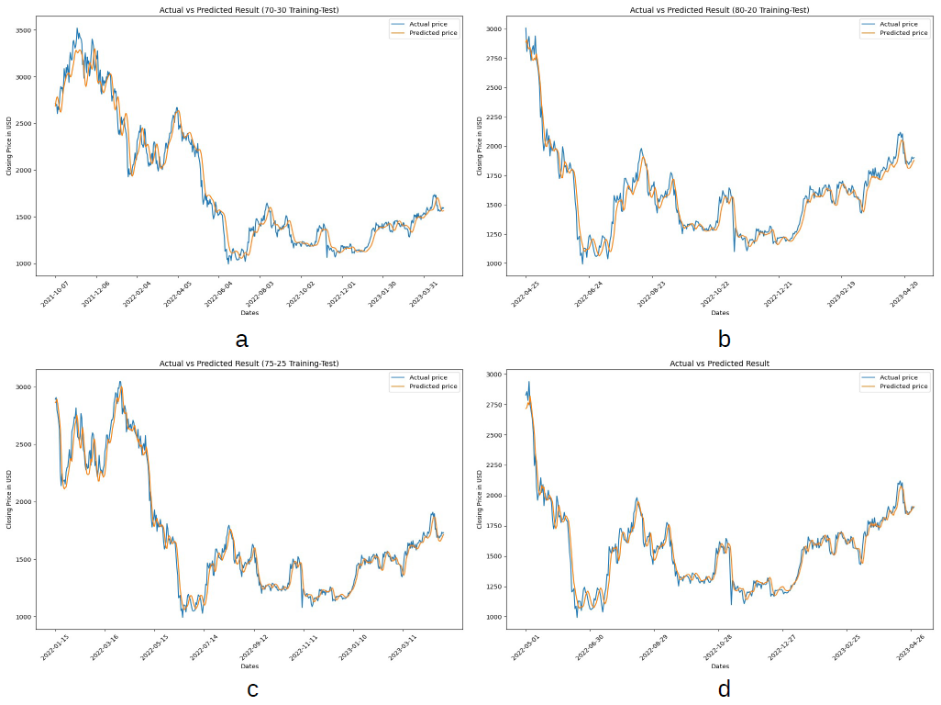
Part 1 Results
Plots of test set for predicted values of closing price compared with actual values for LSTM model with dropout rates (a: 70-30 training-test, b: 80-20 training-test, c: 75-25 training-test, d: custom training-test).

Slide 15
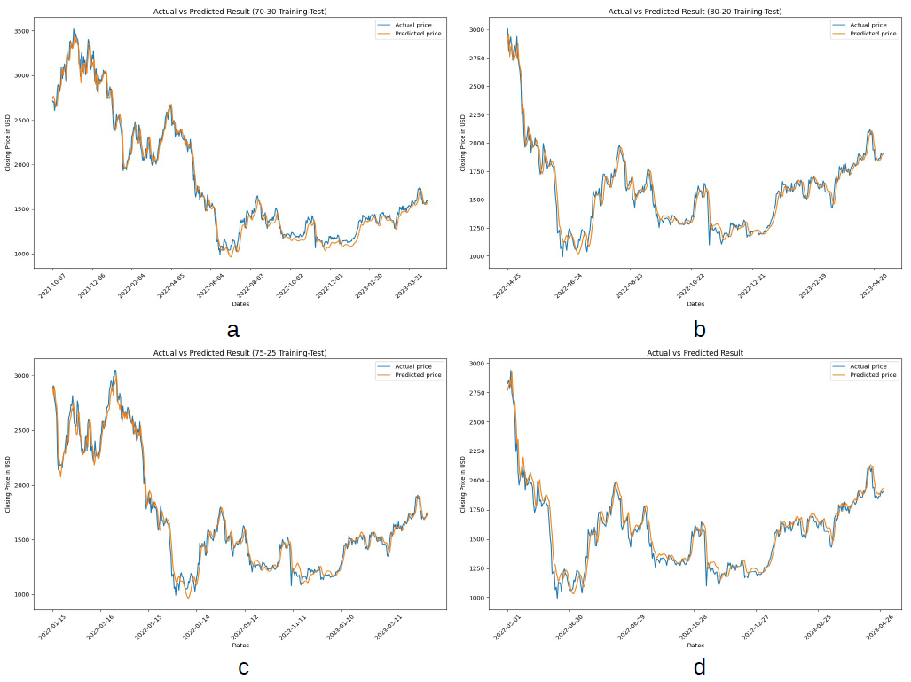
Part 1 Results
Plots of test set for predicted values of closing price compared with actual values for LSTM model with regularizers (a: 70-30 training-test, b: 80-20 training-test, c: 75-25 training-test, d: custom training-test).

Slide 16
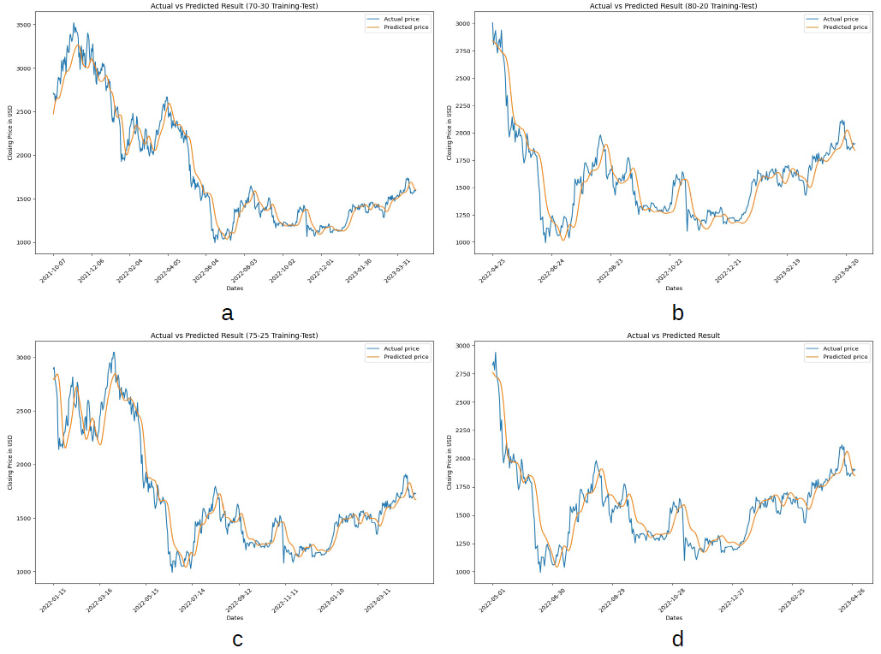
Part 1 Results
Plots of test set for predicted values of closing price compared with actual values for LSTM model with dropout rates and regularizers (a: 70-30 training-test, b: 80-20 training-test, c: 75-25 training-test, d: custom training-test).

Slide 17
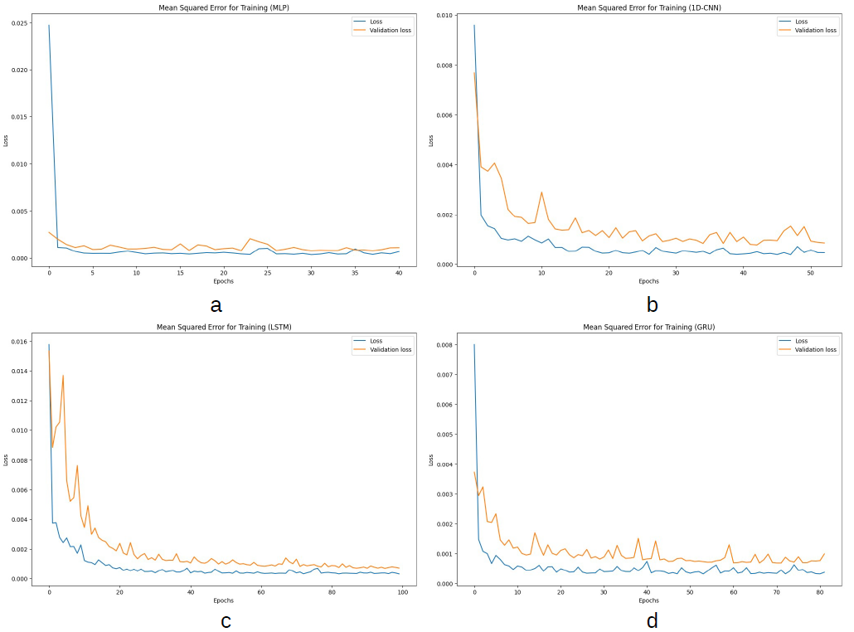
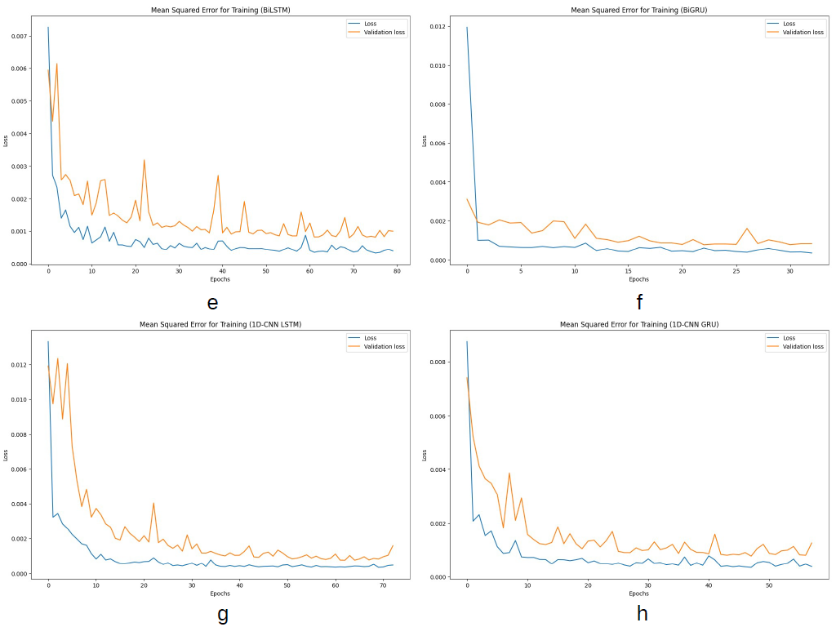
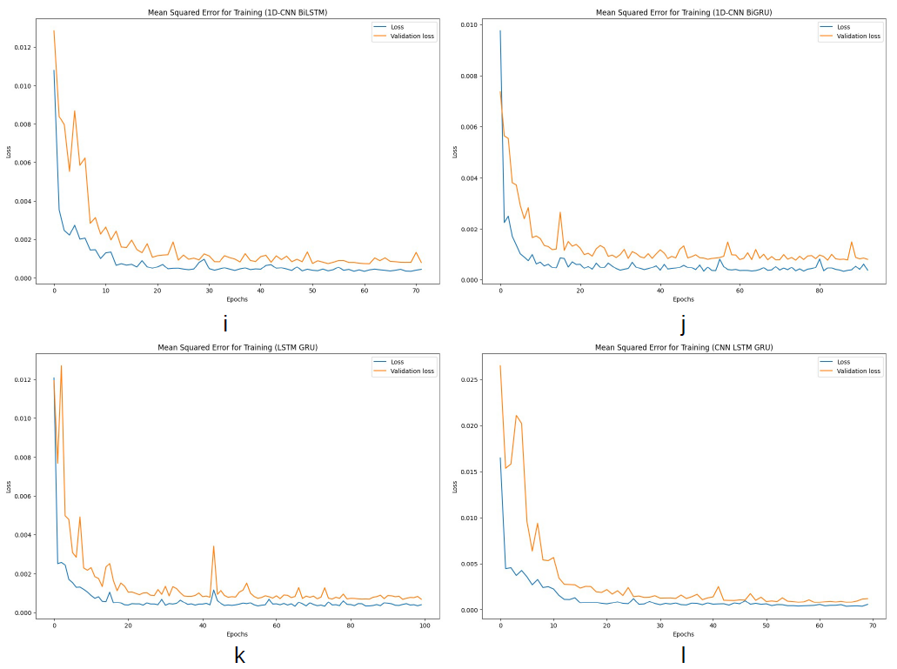
Part 2 Results
Training loss for baseline models (a: multilayer perceptron (MLP), b: convolutional neural network (CNN), c: long short-term memory (LSTM), d: gated recurrent unit (GRU), e: bidirectional LSTM (BiLSTM), f: bidirectional GRU (BiGRU), g: CNN-LSTM, h: CNN-GRU, i: CNN-BiLSTM, j: CNN-BiGRU, k: LSTM-GRU, l: CNN-LSTM-GRU).

Slide 18
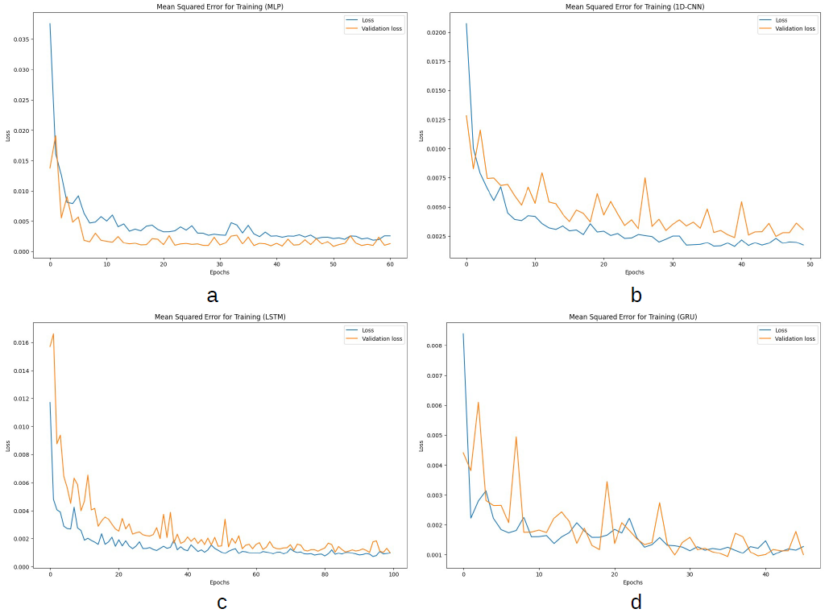
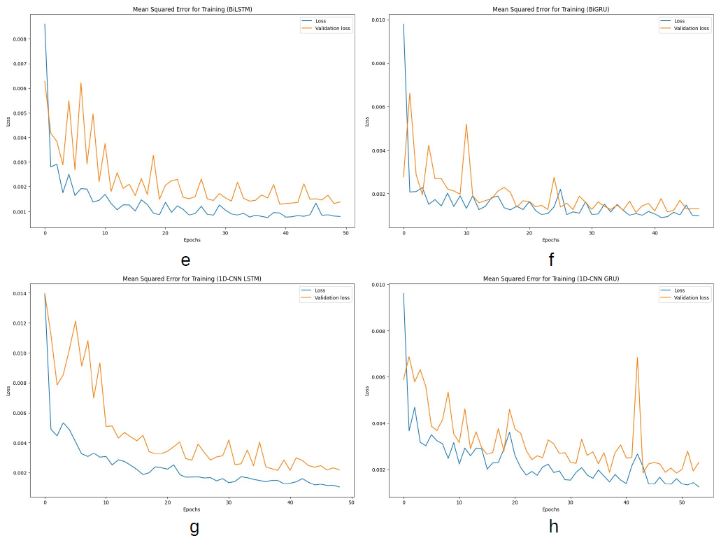
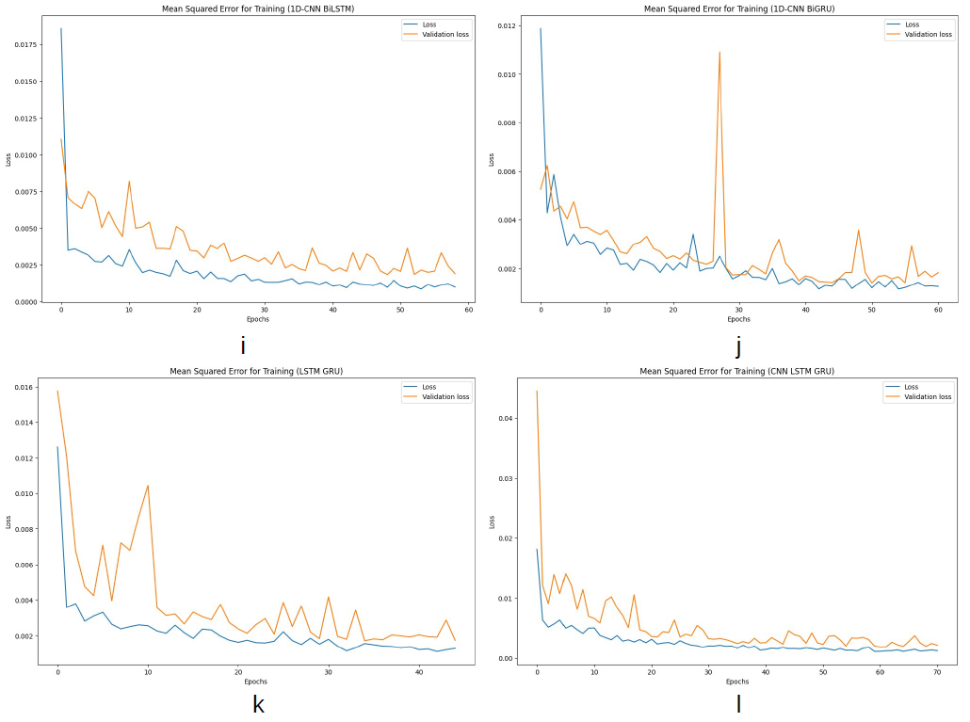
Part 2 Results
Training loss for models with dropout rates (a: multilayer perceptron (MLP), b: convolutional neural network (CNN), c: long short-term memory (LSTM), d: gated recurrent unit (GRU), e: bidirectional LSTM (BiLSTM), f: bidirectional GRU (BiGRU), g: CNN-LSTM, h: CNN-GRU, i: CNN-BiLSTM, j: CNN-BiGRU, k: LSTM-GRU, l: CNN-LSTM-GRU).

Slide 19
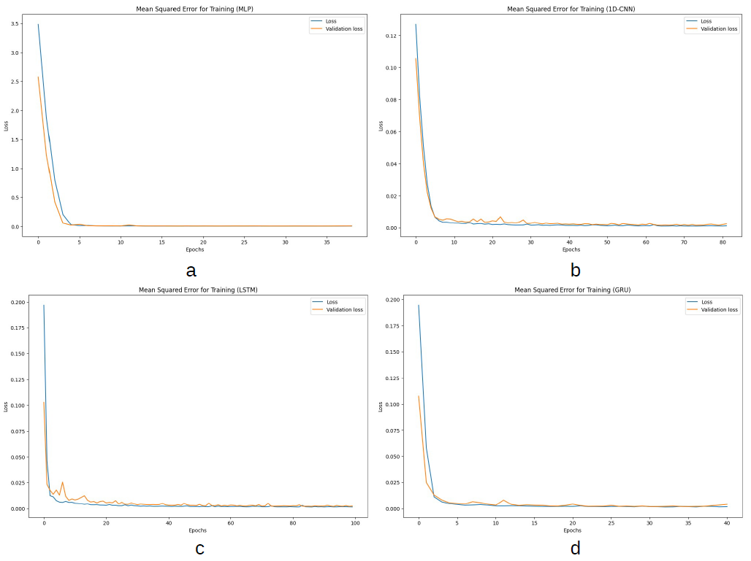
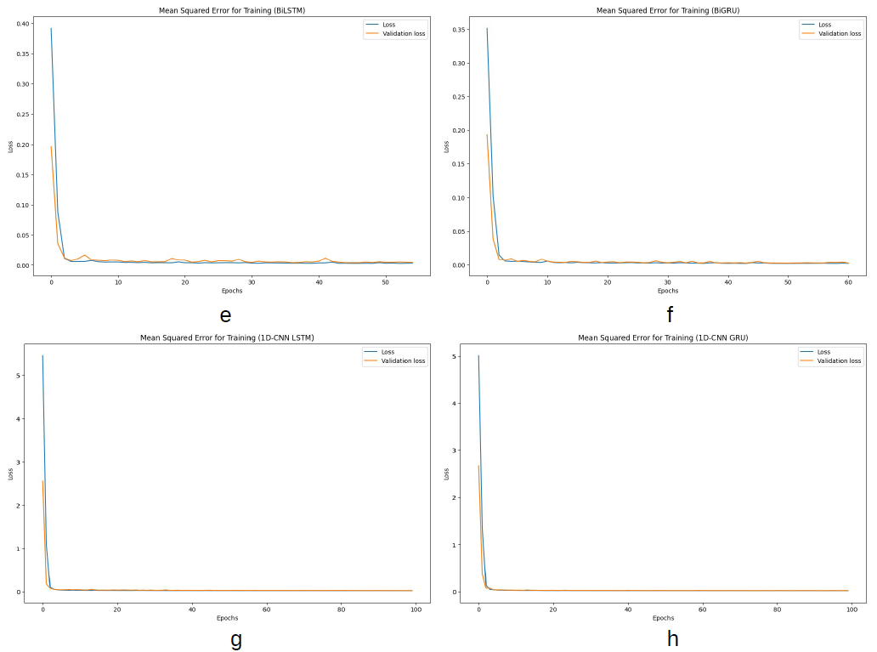
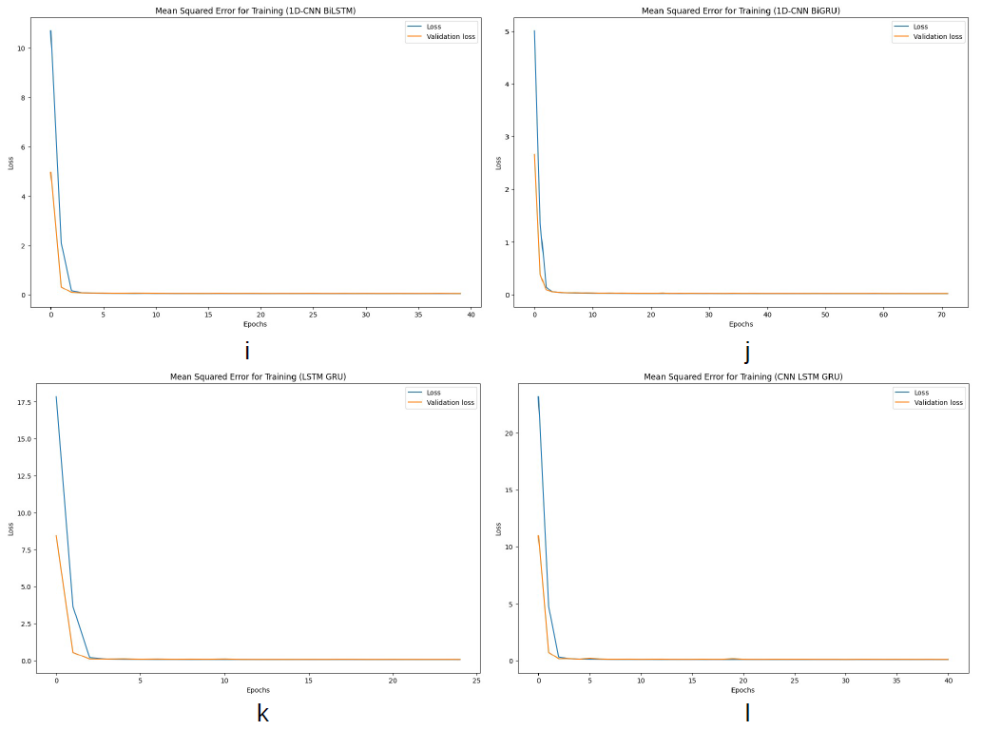
Part 2 Results
Training loss for models with regularizers (a: multilayer perceptron (MLP), b: convolutional neural network (CNN), c: long short-term memory (LSTM), d: gated recurrent unit (GRU), e: bidirectional LSTM (BiLSTM), f: bidirectional GRU (BiGRU), g: CNN-LSTM, h: CNN-GRU, i: CNN-BiLSTM, j: CNN-BiGRU, k: LSTM-GRU, l: CNN-LSTM-GRU).

Slide 20
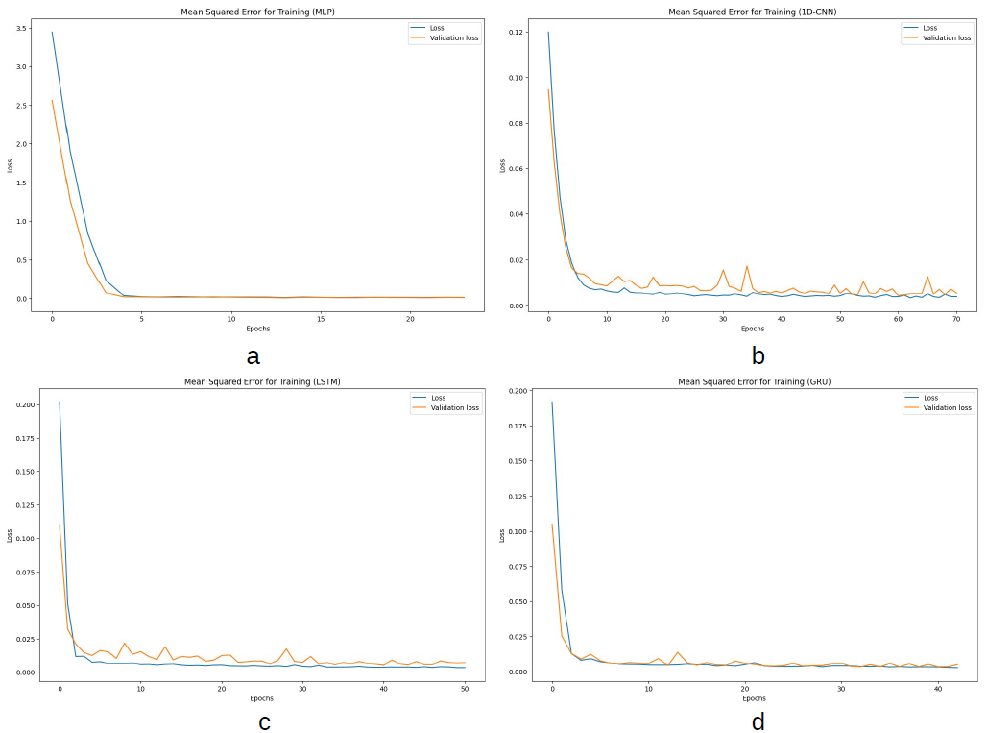
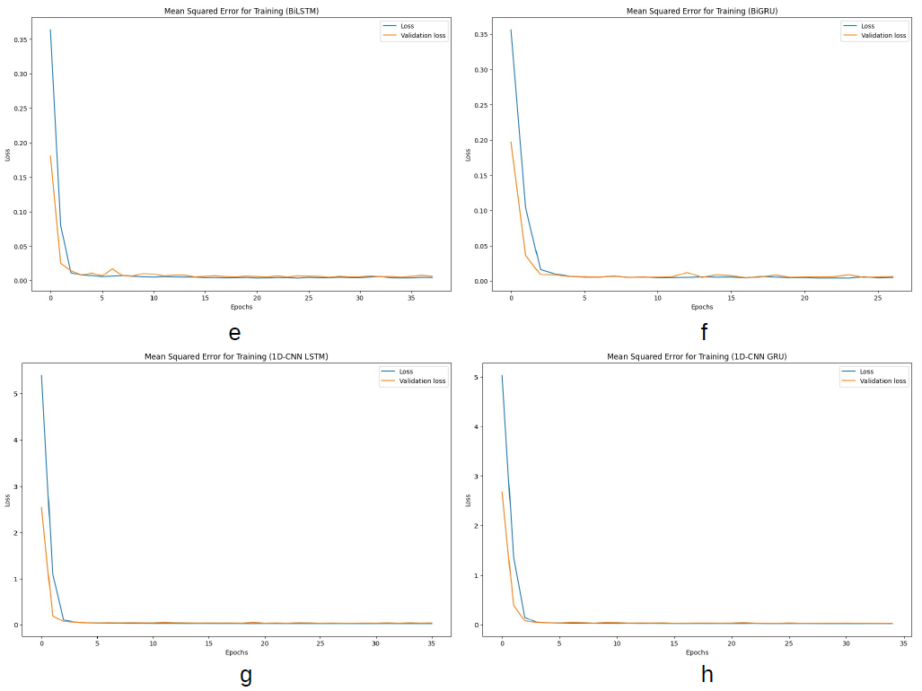
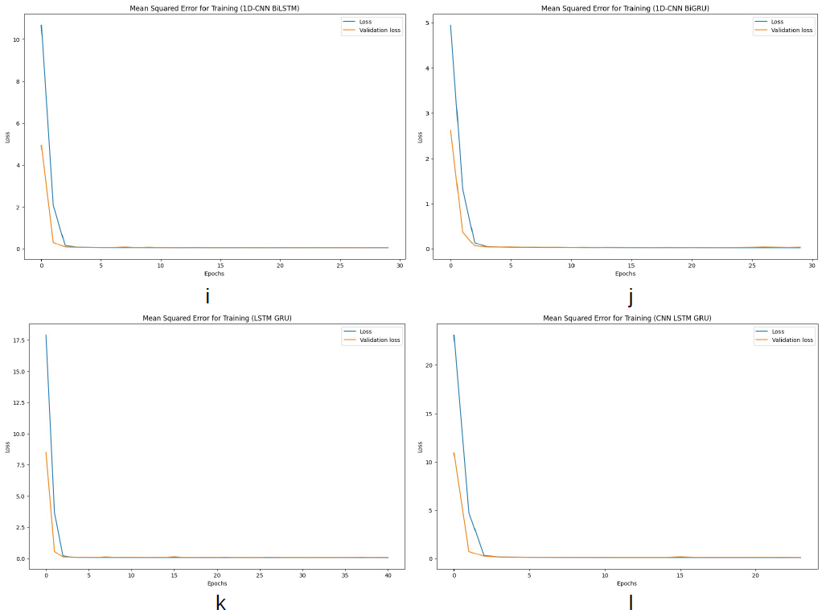
Part 2 Results
Training loss for models with dropout rates and regularizers (a: multilayer perceptron (MLP), b: convolutional neural network (CNN), c: long short-term memory (LSTM), d: gated recurrent unit (GRU), e: bidirectional LSTM (BiLSTM), f: bidirectional GRU (BiGRU), g: CNN-LSTM, h: CNN-GRU, i: CNN-BiLSTM, j: CNN-BiGRU, k: LSTM-GRU, l: CNN-LSTM-GRU).

Slide 21
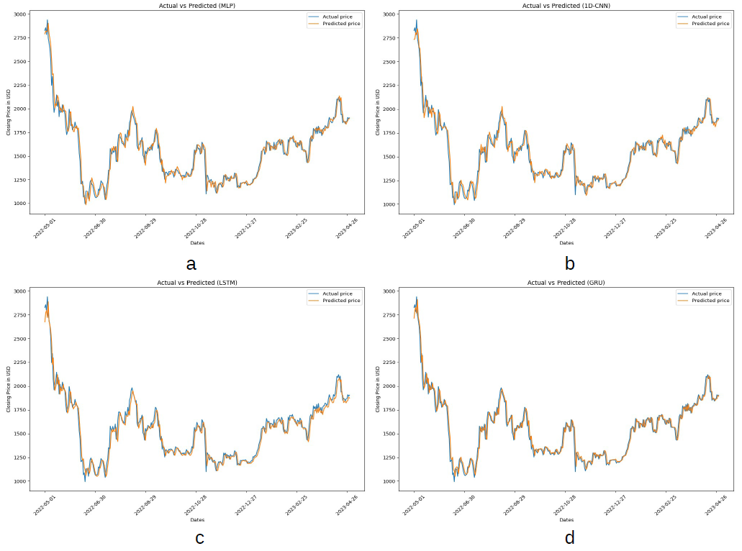
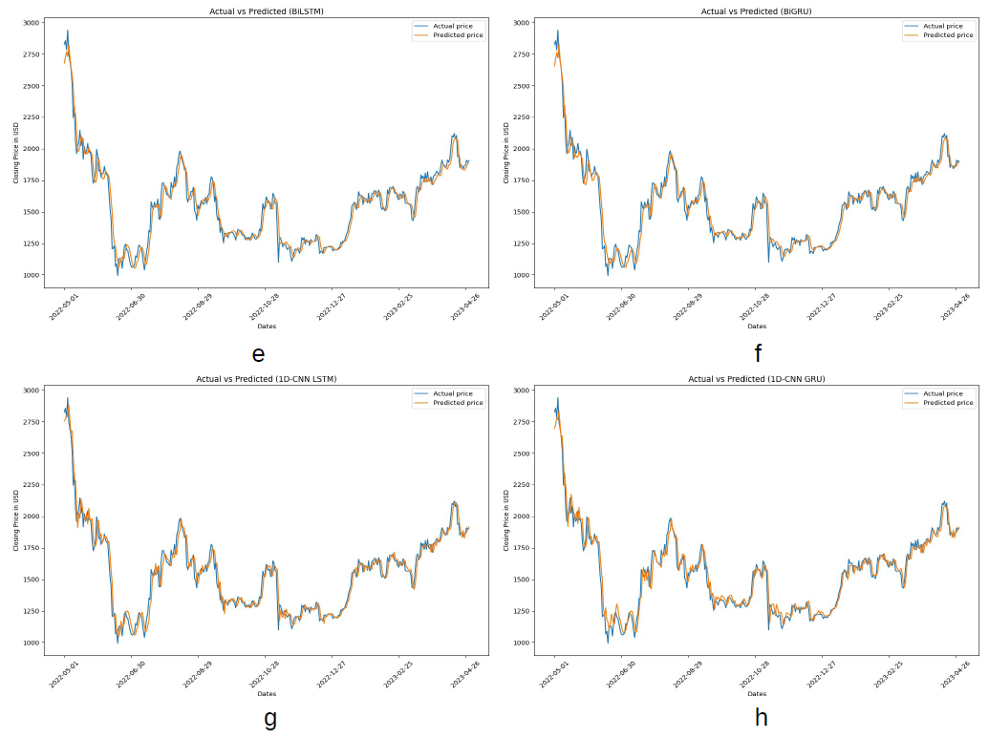
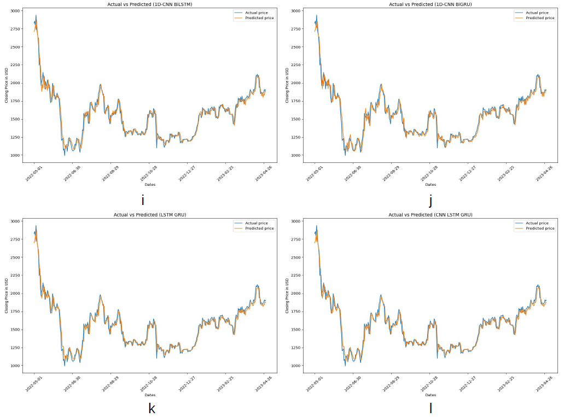
Part 2 Results
Plots of test set for predicted values of closing price compared with actual values for baseline models (a: multilayer perceptron (MLP), b: convolutional neural network (CNN), c: long short-term memory (LSTM), d: gated recurrent unit (GRU), e: bidirectional LSTM (BiLSTM), f: bidirectional GRU (BiGRU), g: CNN-LSTM, h: CNN-GRU, i: CNN-BiLSTM, j: CNN-BiGRU, k: LSTM-GRU, l: CNN-LSTM-GRU).

Slide 22
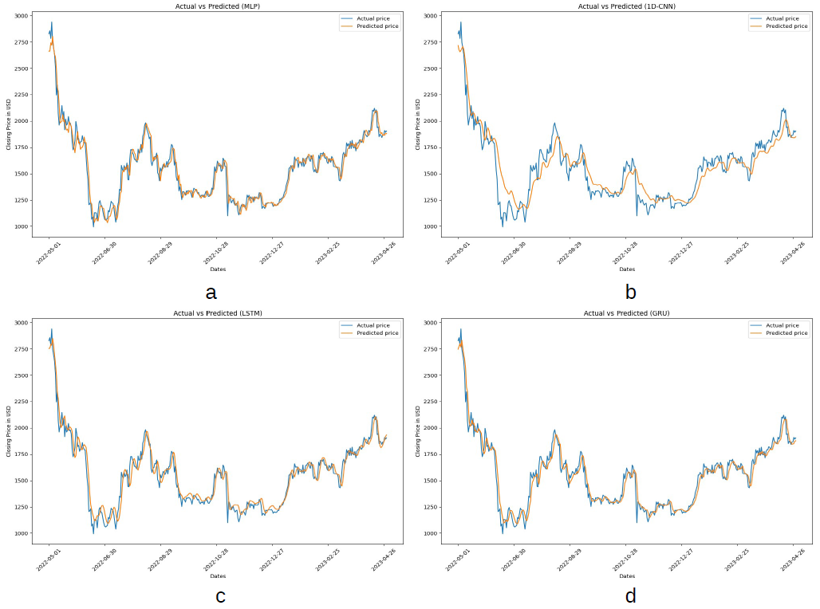
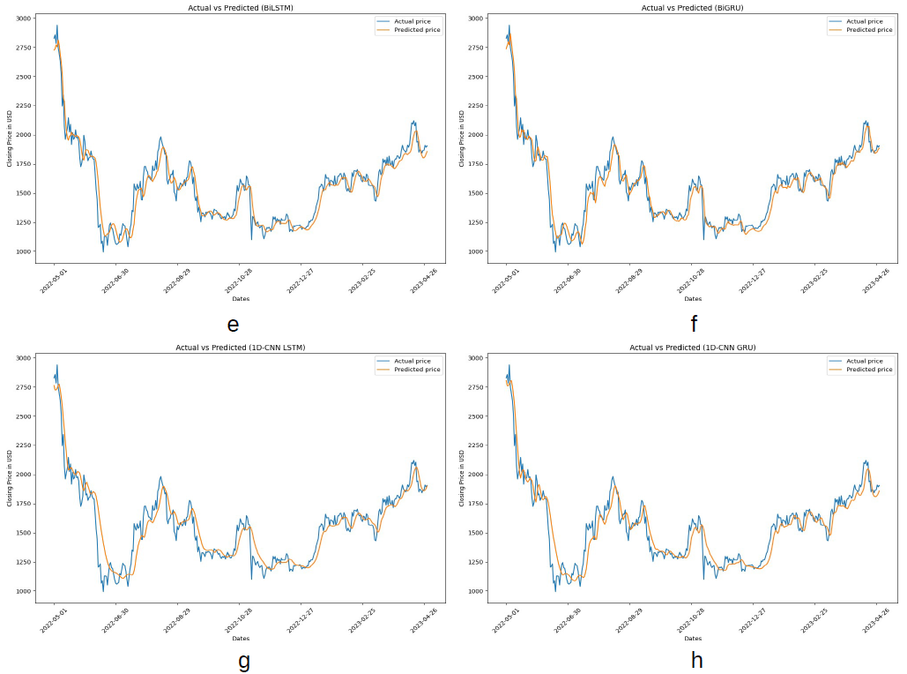
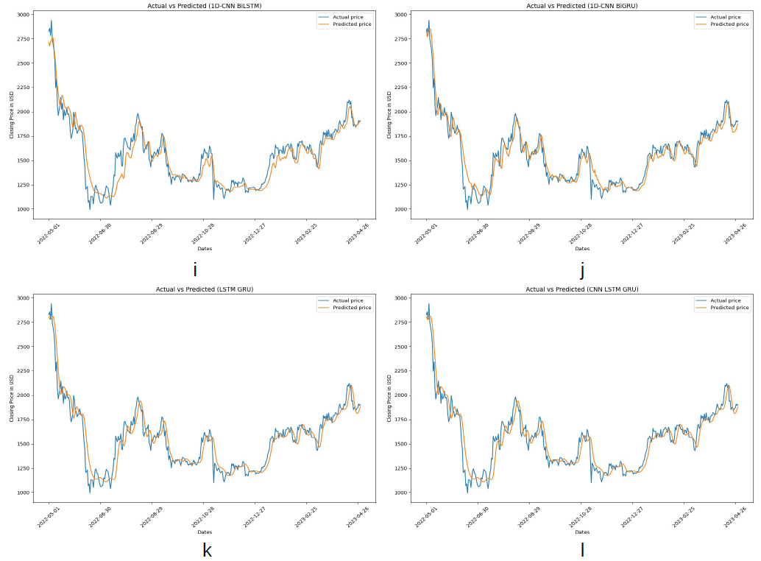
Part 2 Results
Plots of test set for predicted values of closing price compared with actual values for models with dropout rates (a: multilayer perceptron (MLP), b: convolutional neural network (CNN), c: long short-term memory (LSTM), d: gated recurrent unit (GRU), e: bidirectional LSTM (BiLSTM), f: bidirectional GRU (BiGRU), g: CNN-LSTM, h: CNN-GRU, i: CNN-BiLSTM, j: CNN-BiGRU, k: LSTM-GRU, l: CNN-LSTM-GRU).

Slide 23
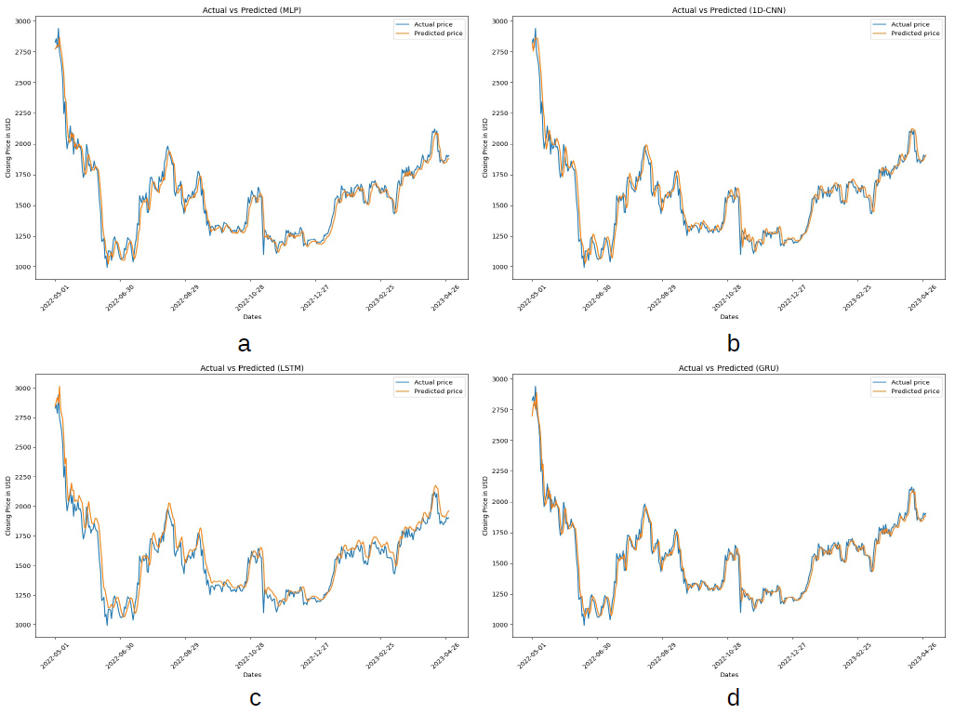
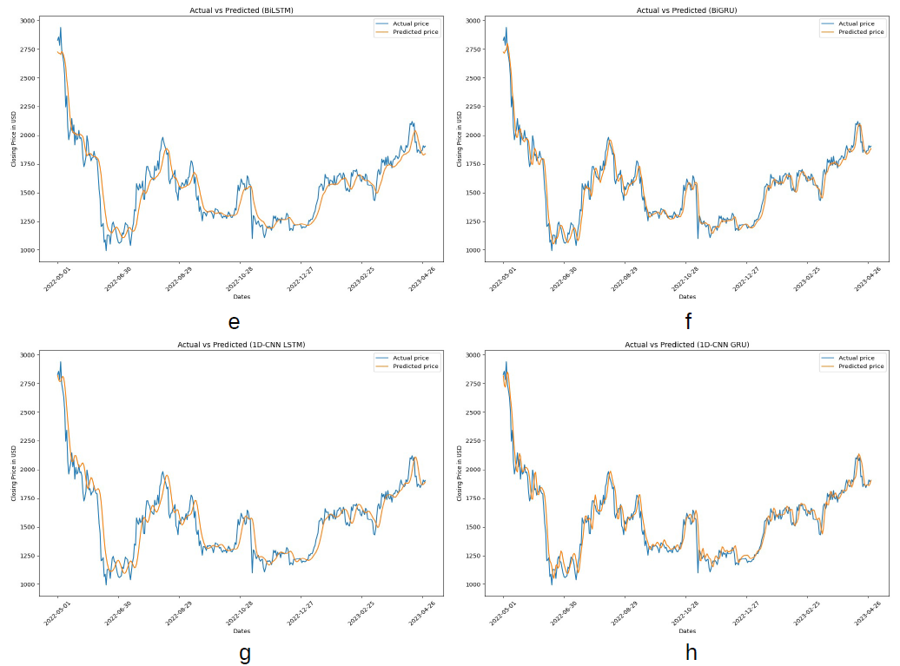
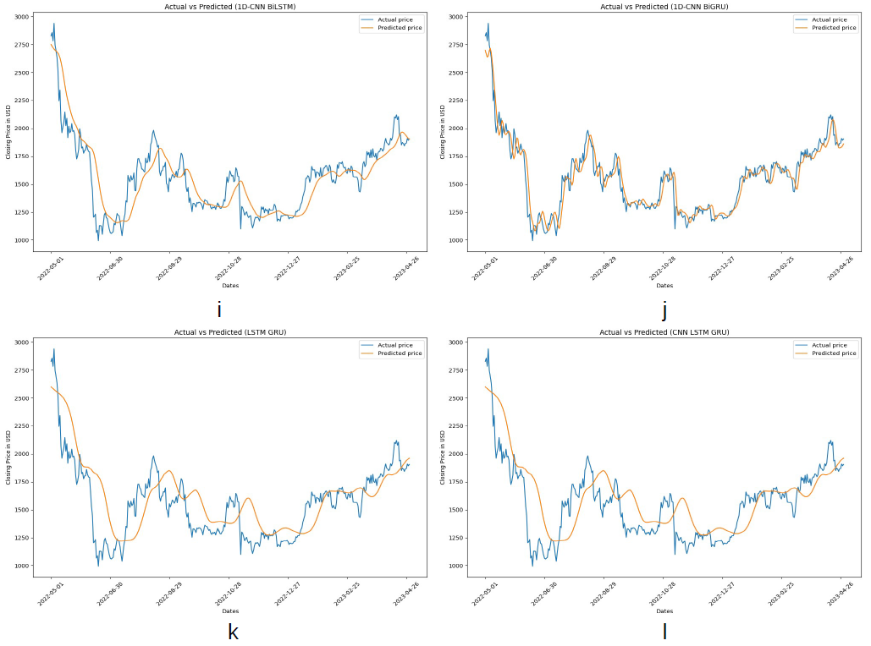
Part 2 Results
Plots of test set for predicted values of closing price compared with actual values for models with regularizers (a: multilayer perceptron (MLP), b: convolutional neural network (CNN), c: long short-term memory (LSTM), d: gated recurrent unit (GRU), e: bidirectional LSTM (BiLSTM), f: bidirectional GRU (BiGRU), g: CNN-LSTM, h: CNN-GRU, i: CNN-BiLSTM, j: CNN-BiGRU, k: LSTM-GRU, l: CNN-LSTM-GRU).

Slide 24
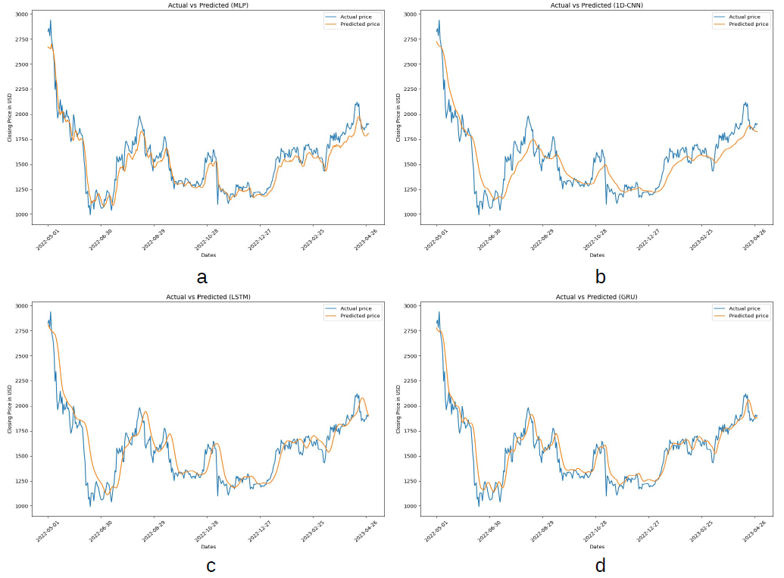
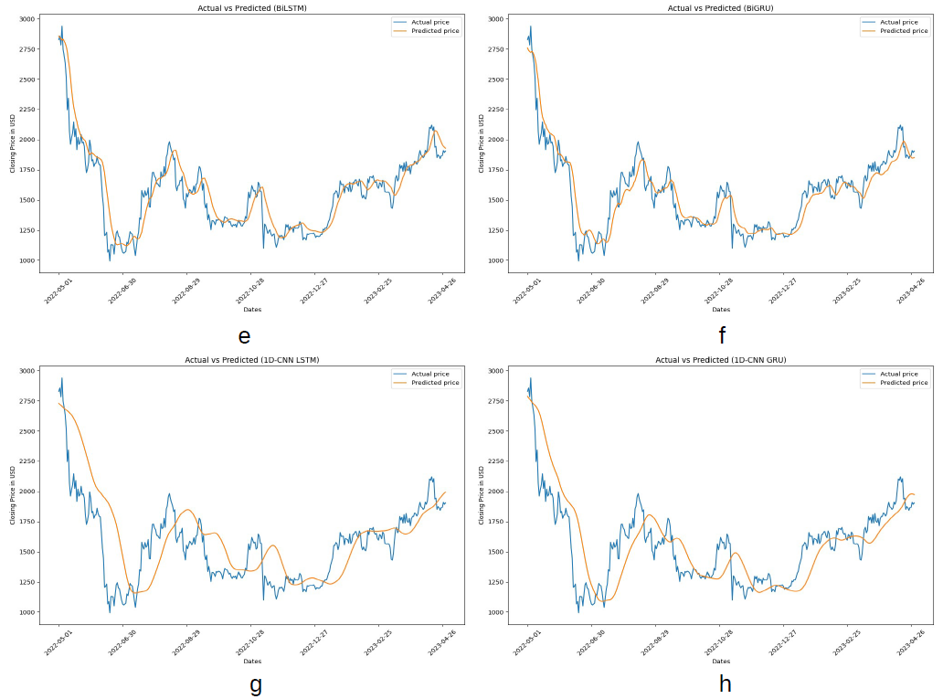
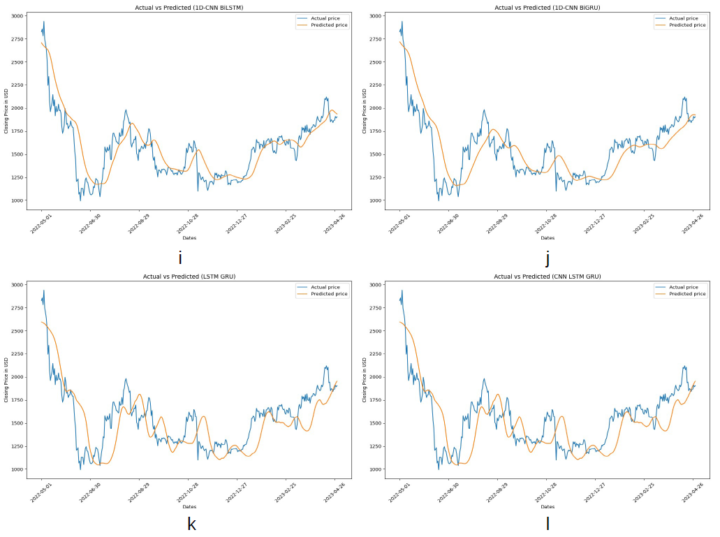
Part 2 Results
Plots of test set for predicted values of closing price compared with actual values for models with dropout rates and regularizers (a: multilayer perceptron (MLP), b: convolutional neural network (CNN), c: long short-term memory (LSTM), d: gated recurrent unit (GRU), e: bidirectional LSTM (BiLSTM), f: bidirectional GRU (BiGRU), g: CNN-LSTM, h: CNN-GRU, i: CNN-BiLSTM, j: CNN-BiGRU, k: LSTM-GRU, l: CNN-LSTM-GRU).

Slide 25
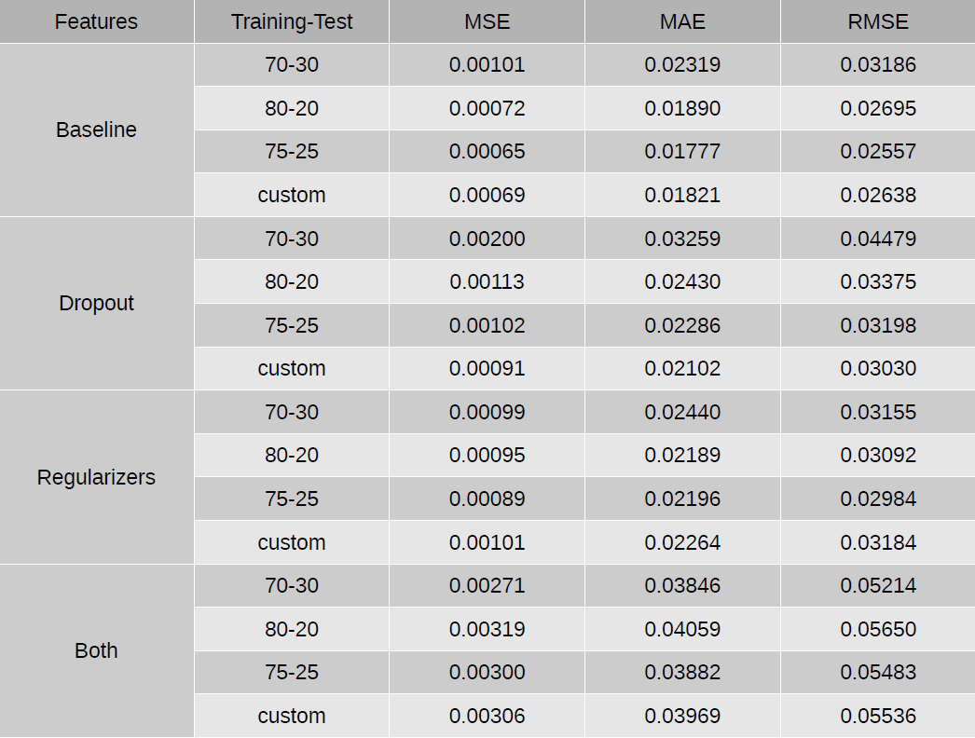
Part 1 Results: The comparison of LSTM models’ training loss metrics based on training-test lengths.

Slide 26
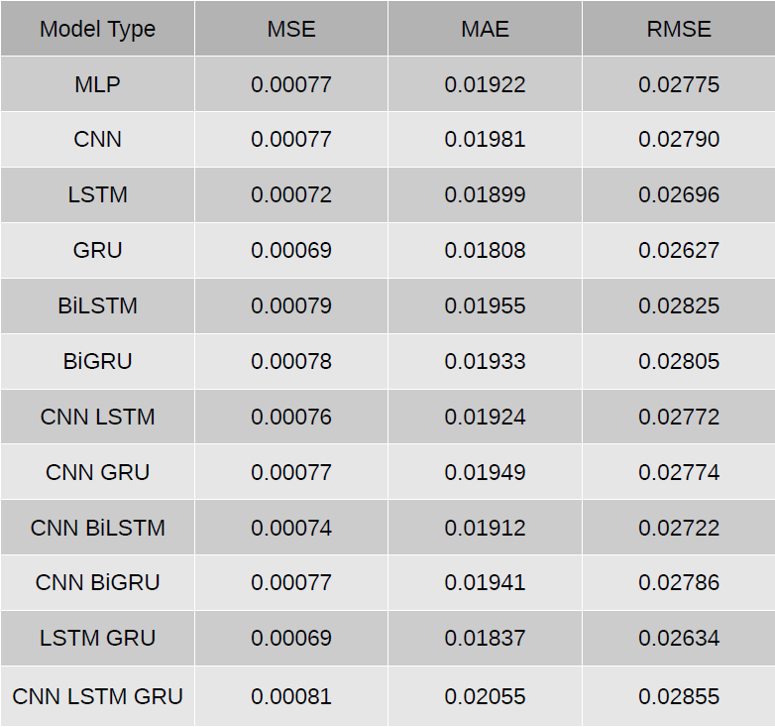
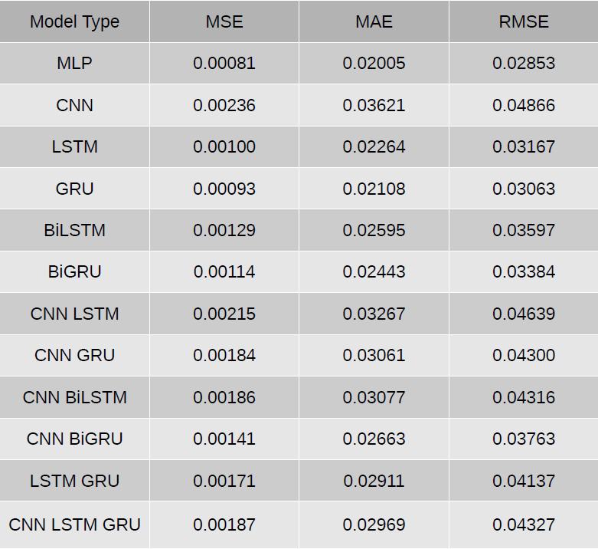
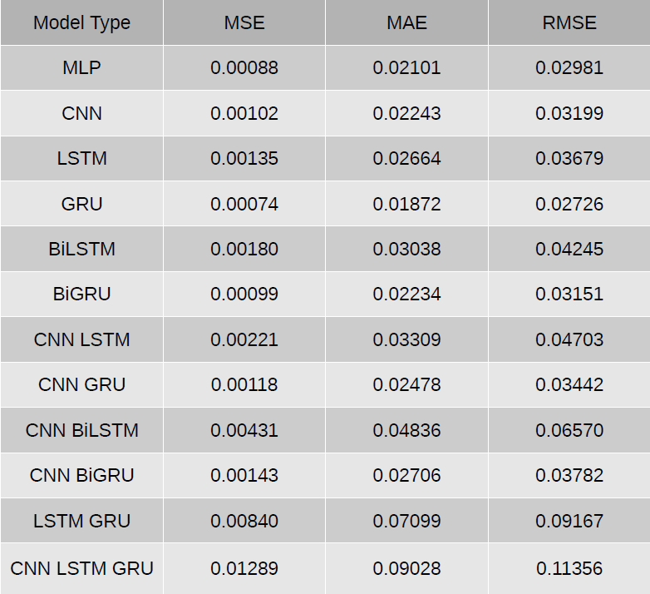
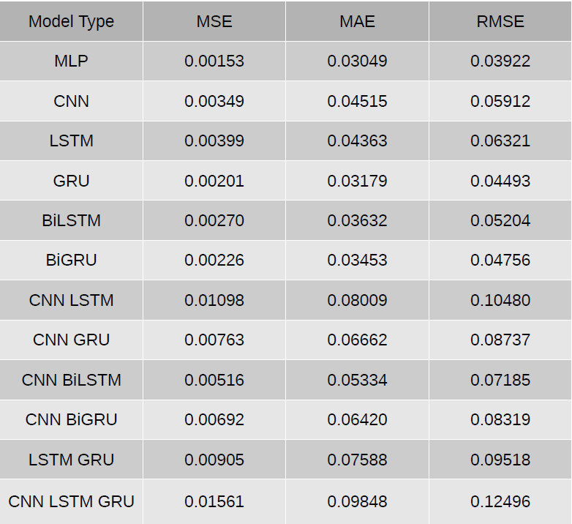
Part 2 Results: The comparison of all neural networks’ training loss metrics based on features (from left to right: baseline, with dropout rates, with regularizers, with dropout rates and regularizers)

Slide 27
Issues and Challenges?
GPU Runtime mode limitations while using Colab
Occasionally, the entire process may end abruptly if notebook is left idle for too long.
The same issue can happen anytime during the training process.
Anomalies found while plotting training losses and predicted price trends, such as sudden spikes for models using dropout rates and predicted plots failing to correlate well with actual plots in certain graph areas
Some models may outperform one another depending on what features are added in the neural networks (i.e., baseline GRU model does better than all other models, yet MLP model with dropout rates and regularizers outperforming all other models)
Any of the issues above (except the first one) can happen anytime since each results generated from running the notebooks may be different for each new experiment.

Slide 28
Conclusion
Deep learning models are effective in providing accurate forecasting predictions on how the Ethereum market price changes over time. LSTM not only remain an effective approach in handling long-term memory of the price lists, but also capable in minimizing the likelihood of exploding/vanishing gradients during the training process.
While the results obtained may not necessarily correlate with the actual trends, it provides a bigger picture on how the price list can change course due to external factors in the stock market.
Thus, while LSTM-RNN cannot guarantee optimal results all the time due to the stochastic property like all other neural networks, it remains relevant in forecasting long-term predictions of ETH prices and observing how the changes in behavior of the market will affect the outlook.

Slide 29
What’s next?
If there are improvements or additional things to consider for future work:
Try different number of units for each LSTM layer
Increase the patience value for early stopping (patience is how many additional epochs to train before halting early if no further improvements are detected for any metric, like validation loss)
Adjust the regularizer and dropout rate values
Increase the number of epochs for training
Rearrange the architectures for hybrid models
Try out the following methodologies listed below and see whether the results obtained can outperform existing models in terms of performance metrics:
Generative adversarial networks (GAN)
Transfer Learning
Support vector machines (SVM)
Boltzmann machines

Slide 30
The end

